Slide 1
Numeric and Categorical Structured Data Visualization- Part1 (Univariate+ Multivariate , Part1)

Slide 2
Learning Outcome
Introduction to Numeric and Categorical Structured Data Visualization- Part1 (Univariate)
Introduction to Numeric and Categorical Structured Data Visualization- Part2 (Multivariate)
We will learn various visualisation techniques like, Pie Charts, Bar Charts, Line Charts etc.

Slide 3
Outline
Numeric and Categorical Structured Data Visualization- Part1 (Univariate)
Pie Charts
Bar Charts
Line Charts
Histogram Charts
Stacked Bar Charts
Grouped Bar Charts
Combination Line and Bar Charts
Error Charts

Slide 4
Numeric and Categorical Structured Data Visualization- Part1 (Univariate)

Slide 5
Pie Charts

Slide 6
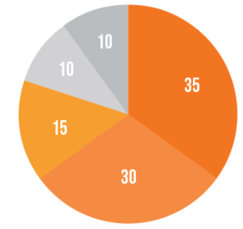
Pie Charts
Pie charts or circle charts are circle-shaped charts, that are divided into slices to depict numerical proportions.

Slide 7
Pie Charts
contd
Pie Charts help show proportions and percentages between categories, by dividing a circle into proportional segments.
Each arc length represents a proportion of each category, while the full circle represents the total sum of all the data, equal to 100%.
Pie Charts are ideal for giving the reader a quick idea of the proportional distribution of the data.
These are used typically for nominal scales, i.e., no specific order between the values.

Slide 8
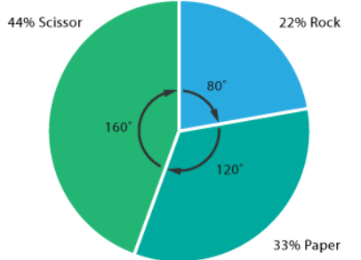
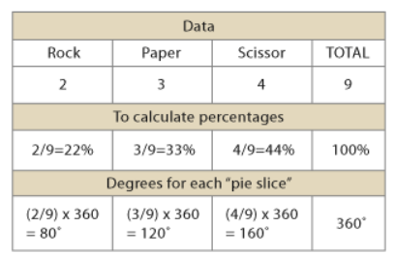
Pie Charts
contd
Example
https://datavizcatalogue.com/methods/pie_chart.html

Slide 9
Pie chart in Python
Pie Chart can only display one series of data.
Pie charts show the size of items (called wedge) in one data series, proportional to the sum of the items.
The data points in a pie chart are shown as a percentage of the whole pie.
Matplotlib API
has a pie() function that generates a pie diagram representing data in an array.
The fractional area of each wedge is given by x/sum(x).

Slide 10
Pie chart in Python
contd
x | array-like. The wedge sizes.
labels | list. A sequence of strings providing the labels for each wedge.
Colors | A sequence of matplotlib colorargs through which the pie chart will cycle. If None, will use the colors in the currently active cycle.
Autopct | string, used to label the wedges with their numeric value. The label will be placed inside the wedge. The format string will be fmt%pct.

Slide 11
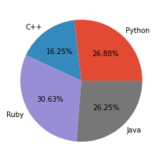
Pie chart in Python
contd
Type 1: Basic
import matplotlib.pyplot as plt
# Data to plot
labels = ['Python', 'C++', 'Ruby', 'Java']
sizes = [215, 130, 245, 210]
# Plot
plt.pie(sizes, labels=labels, autopct='%1.2f%%')
plt.show()

Slide 12
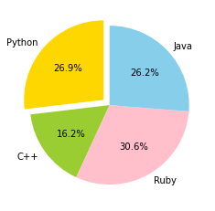
Pie chart in Python
contd
Type 2: change color, explode and use start angle
import matplotlib.pyplot as plt
# Data to plot
labels = 'Python', 'C++', 'Ruby', 'Java'
sizes = [215, 130, 245, 210]
colors = ['gold', 'yellowgreen', 'pink', 'skyblue']
explode = (0.1, 0, 0, 0) # explode 1st slice
# Plot
plt.pie(sizes, explode=explode, labels=labels, colors=colors,
autopct='%1.1f%%', startangle=90)
plt.show()
Started at 90 degree

Slide 13
Question?(m)
What are the advantages and disadvantages of Pie charts ?
https://channelmix.com/blog/pie-charts-donut-charts/

Slide 14
Question?
Advantage: pie charts are easy to build and use. Easy to understand.
we care only about one or two slices, a pie chart can help highlight the story around those parts.
https://channelmix.com/blog/pie-charts-donut-charts/

Slide 15
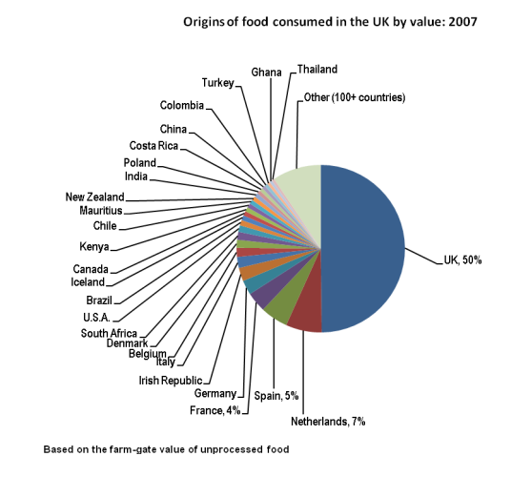
Disadvantages of pie chart
Disadvantages of pie chart:
They cannot show more than a few values, because as the number of values shown increases, the size of each segment/slice becomes smaller. This makes them unsuitable for large amounts of data.
They take up more space than their alternatives, like a 100% Stacked Bar Chart for example. Mainly due to their size and for the usual need for a legend.

Slide 16
Disadvantages of pie chart
Disadvantages of pie chart:
They are not great for making accurate comparisons between groups of Pie Charts. This being that it is harder to distinguish the size of items via area when it is for length.

Slide 17
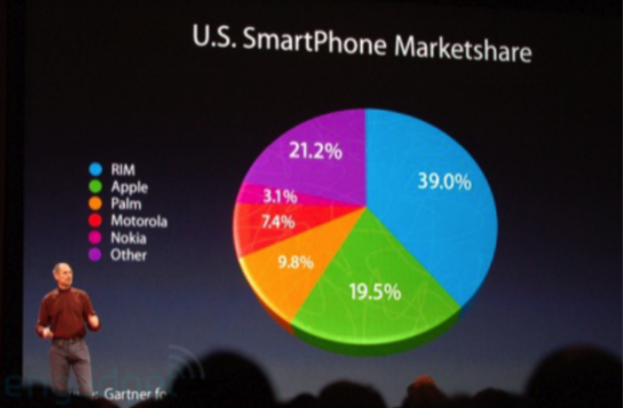
Disadvantages of pie chart
contd
A famous example for that can be seen below.
The audience can see the green area significantly bigger than it really is.
It looks like it is almost the same size as the blue area. Even the human brain has its limits and it is easy to influence this way
https://www.answerminer.com/blog/the-ultimate-guide-to-pie-chart-visualization

Slide 18
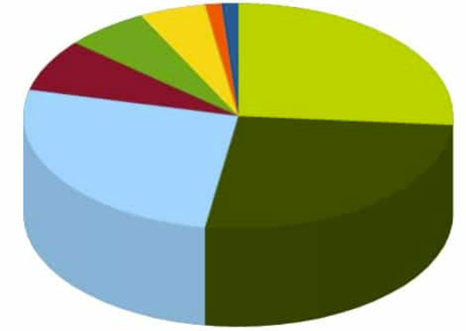
Question?(m)
Light green, dark green, light blue which is greater?

Slide 19
Question?(m)
Light green, dark green, light blue which is greater?
They are all equal. Pie chart becomes difficult to understand because they use 3D or “exploded” views that distort what they’re trying to say.

Slide 20
Donut charts

Slide 21
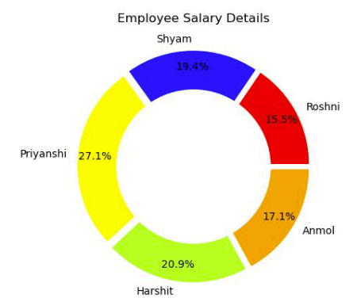
Donut charts
Donut charts are the modified version of Pie Charts with the area of center cut out.
A donut is more concerned about the use of area of arcs to represent the information in the most effective manner
Donut charts are more efficient in terms of space because the blank space inside the donut charts can be used to display some additional information about the donut chart.

Slide 22
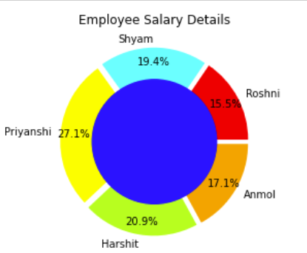
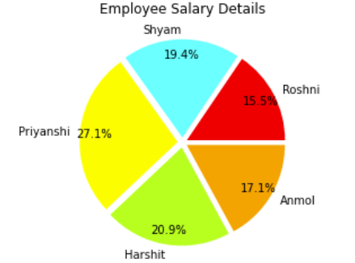
Donut charts
Pie chart + circle = donut chart

Slide 23
Donut charts
Functions - Used
Draw circle
The gcf() & gca() methods stand for get current figure & get current axis respectively. The add_artist() method of axes class is used to add artist to the axis (here referenced by .gca() )
https://www.analyticsvidhya.com/blog/2021/06/donut-plots-data-visualization-with-python/

Slide 24
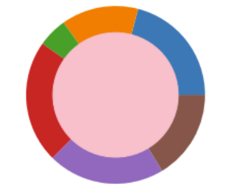
Donut charts
import numpy as np
import matplotlib.pyplot as plt
data = np.random.randint(20, 100, 6)
plt.pie(data)
circle = plt.Circle( (0,0), 0.7, color=‘pink')
p=plt.gcf()
p.gca().add_artist(circle)
plt.show()
https://www.analyticsvidhya.com/blog/2021/06/donut-plots-data-visualization-with-python/

Slide 25
Question? (m)
Can you create nested pie charts/ donut charts?

Slide 26
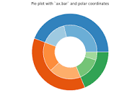
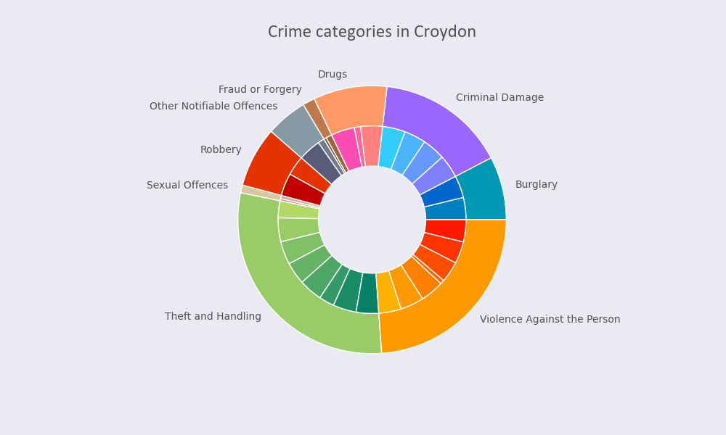
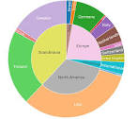
Question?
Can you create nested pie charts/ donut charts?-> Yes

Slide 27
Donut charts
# draw circle
centre_circle = plt.Circle((0, 0), 0.70, fc='blue')
fig = plt.gcf()
# Adding Circle in Pie chart
fig.gca().add_artist(centre_circle)
# Adding Title of chart
plt.title('Employee Salary Details')
# Displaying Chart
plt.show()
import matplotlib.pyplot as plt
# Setting labels for items in Chart
Employee = ['Roshni', 'Shyam', 'Priyanshi',
'Harshit', 'Anmol']
# Setting size in Chart based on
# given values
Salary = [40000, 50000, 70000, 54000, 44000]
# colors
colors = ['#FF0000', '#00ffFF', '#FFFF00',
'#ADFF2F', '#FFA500']
# explosion
explode = (0.05, 0.05, 0.05, 0.05, 0.05)
# Pie Chart
plt.pie(Salary, colors=colors, labels=Employee,
autopct='%1.1f%%', pctdistance=0.85,
explode=explode)
Draw pie chart
Draw circle
Get the current figure plt.gcf()
Get the figure axis (fig.gca())
Use Add_artist() to combine
The gcf() & gca() methods stand for get current figure & get current axis respectively. The add_artist() method of axes class is used to add artist to the axis (here referenced by .gca() )

Slide 28
Bar Charts

Slide 29
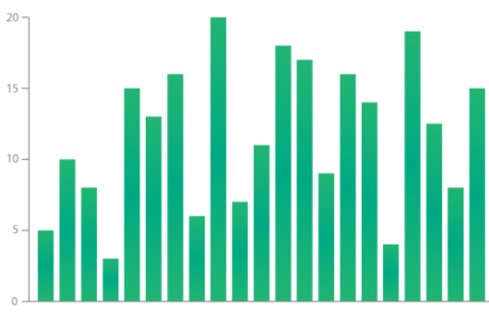
Bar Charts
A bar chart is a chart with rectangular bars with lengths proportional to the values that they represent.
Bar charts provide a visual presentation of categorical data. Bar charts are used to represent frequencies of different categories.
Bars on the chart may be arranged in any order.

Slide 30
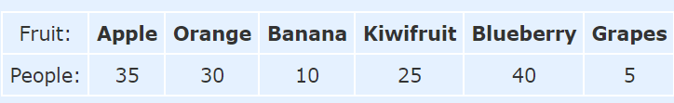
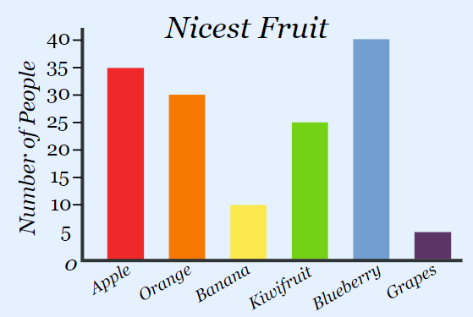
Bar Charts
Example: A survey of 145 people asked them "Which is the nicest fruit?
And here is the bar graph:
That group of people think Blueberries are the nicest.
contd
https://www.mathsisfun.com/data/bar-graphs.html

Slide 31
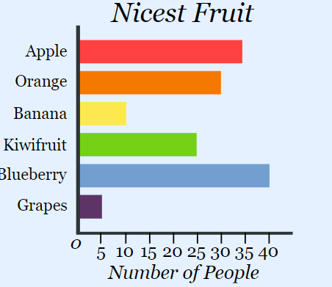
Bar Charts
contd
Bar Graphs can also be Horizontal, like this:

Slide 32
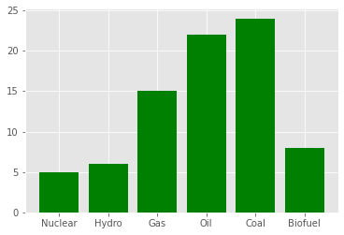
Plotting Bar Charts in Python
Type 1: Basic
import matplotlib.pyplot as plt
x = ['Nuclear', 'Hydro', 'Gas', 'Oil', 'Coal', 'Biofuel']
energy = [5, 6, 15, 22, 24, 8]
plt.bar(x, energy, color='green')
plt.show()

Slide 33
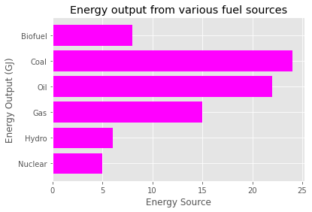
Plotting Bar Charts in Python
Type 2: changing color, adding title, axis labels and Convert it to horizontal direction
import matplotlib.pyplot as plt
x = ['Nuclear', 'Hydro', 'Gas', 'Oil', 'Coal', 'Biofuel']
energy = [5, 6, 15, 22, 24, 8]
plt.barh(x, energy, color='magenta’)
plt.title("Energy output from various fuel sources")
plt.ylabel("Energy Output (GJ)")
plt.xlabel("Energy Source")
plt.show()

Slide 34
Question?(m)
contd
Advantages or disadvantages of Bar charts?
You can adjust it to some extent

Slide 35
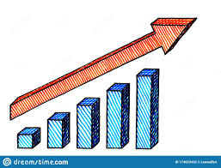
Question
Easy to understand
Make trends easier to highlight than tables do
it helps in studying patterns over long period of time

Slide 36
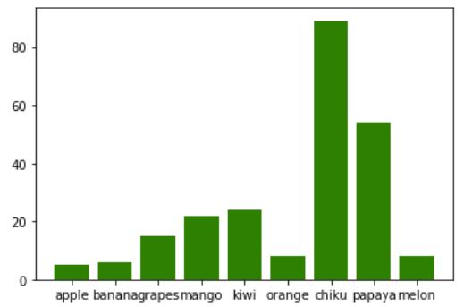
Disadvantages of Bar Charts
contd
Disadvantages of bar charts
One major flaw with Bar Charts is that labelling becomes problematic when there are a large number of bars.
You can adjust it to some extent

Slide 37
Line Charts

Slide 38
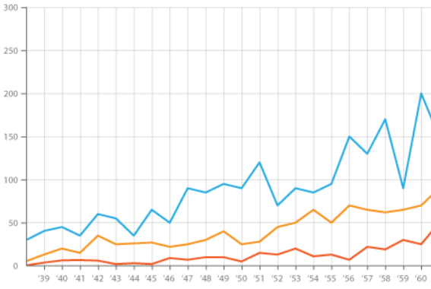
Line Charts
A line chart is used to show the change of data over a continuous time interval or time span.
It is characterized by a tendency to reflect things as they change over time

Slide 39
Line Charts
contd
Line Graphs are drawn by first plotting data points on a Cartesian coordinate grid, then connecting a line between all of these points.
Typically, the y-axis has a quantitative value, while the x-axis is a timescale or a sequence of intervals.
Negative values can be displayed below the x-axis.

Slide 40
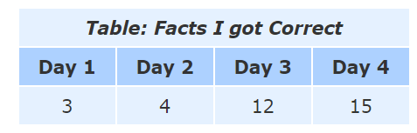
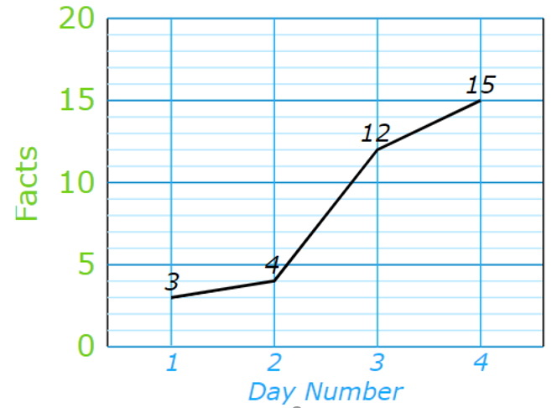
Line Charts
contd
Example: You are learning facts about dogs, and each day you do a short test to see how good you are.
These are the results:
And here is the same data as a Line Graph:

Slide 41
Line Charts
contd
In real life we often see line plots to analyze the evolution of assets in the stock market or, say, to analyze child mortality rates in a given country over time, or how the GDP of a country has evolved over time.
The line's journey across the graph can create patterns that reveal trends in a dataset.
an upward slope indicates where values have increased and a downward slope indicates where values have decreased.
When grouped with other lines (other data series), individual lines can be compared to one another.
However, avoid using more than 3-4 lines per graph, as this makes the chart more cluttered and harder to read.

Slide 42
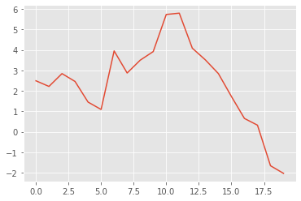
Line Charts in Python
Type 1: Basic
import matplotlib.pyplot as plt
import numpy as np
# create data
values=np.cumsum(np.random.randn(20))
# use the plot function
plt.plot(values)

Slide 43
Np.cumsum
a = np.array([[1,2,3], [4,5,6]])
>>> a
array([[1, 2, 3], [4, 5, 6]])
>>> np.cumsum(a) array([ 1, 3, 6, 10, 15, 21])
>>> np.cumsum(a, dtype=
) # specifies type of output value(s) array([ 1., 3., 6., 10., 15., 21.])

Slide 44
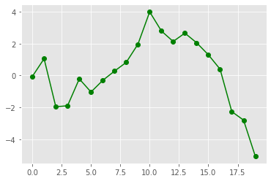
Line Charts in Python
Type2: Adding a ‘marker’
import matplotlib.pyplot as plt
import numpy as np
# create data
values=np.cumsum(np.random.randn(20))
# use the plot function
plt.plot(values, marker = 'o', color ='green')

Slide 45
Histogram Charts

Slide 46
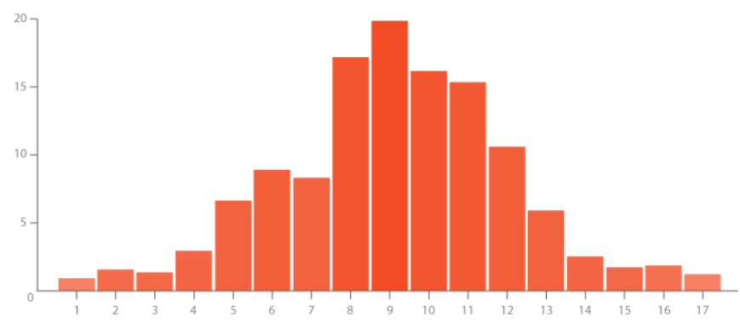
Histogram Charts
A Histogram visualises the distribution of data over a continuous interval or certain time period. Each bar in a histogram represents the tabulated frequency at each interval/bin.
Uses: Histograms help give an estimate as to where values are concentrated, what the extremes are and whether there are any gaps or unusual values.
They are also useful for giving a rough view of the probability distribution.

Slide 47
Histogram Charts
contd
Example: Each month you measure how much weight your pup has gained and get these results:
0.5, 0.5, 0.3, −0.2, 1.6, 0, 0.1, 0.1, 0.6, 0.4
They vary from −0.2 (the pup lost weight that month) to 1.6
Put in order from lowest to highest weight gain:
−0.2, 0, 0.1, 0.1, 0.3, 0.4, 0.5, 0.5, 0.6, 1.6
You decide to put the results into groups of 0.5:
The −0.5 to just below 0 range,
The 0 to just below 0.5 range,
etc...
And here is the result:
https://www.mathsisfun.com/data/histograms.html

Slide 48
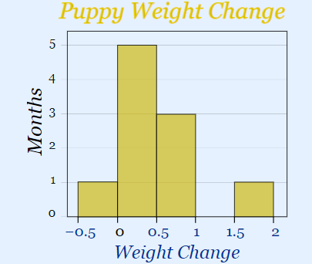
Histogram Charts
contd
And here is the result: 0.5, 0.5, 0.3, −0.2, 1.6, 0, 0.1, 0.1, 0.6, 0.4
(There are no values from 1 to just below 1.5, but we still show the space.)
Range | Frequency
[-0.5- 0) | 1
[ 0-0.5) | 4
[ 0.5-1) | 2
[ 1-1.5)
[ 1.5-2) | 1
https://www.mathsisfun.com/data/histograms.html

Slide 49
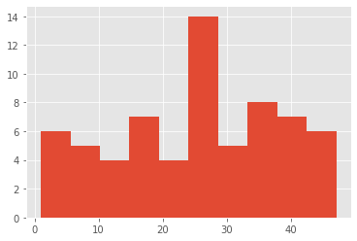
Histogram in Python
Type1: basic
import matplotlib.pyplot as plt
x = [1,1,2,3,3,5,7,8,9,10,
10,11,11,13,13,15,16,17,18,18,
18,19,20,21,21,23,24,24,25,25,
25,25,26,26,26,27,27,27,27,27,
29,30,30,31,33,34,34,34,35,36,
36,37,37,38,38,39,40,41,41,42,
43,44,45,45,46,47
]
plt.hist(x, bins=10)
plt.show()

Slide 50

Histogram in Python
contd
Type 2: making the histogram more readable using ‘rwidth’
import matplotlib.pyplot as plt
x = [1,1,2,3,3,5,7,8,9,10,
10,11,11,13,13,15,16,17,18,18,
18,19,20,21,21,23,24,24,25,25,
25,25,26,26,26,27,27,27,27,27,
29,30,30,31,33,34,34,34,35,36,
36,37,37,38,38,39,40,41,41,42,
43,44,45,45,46,47
]
plt.hist(x, bins=10, rwidth=0.95)
plt.show()

Slide 51
Histograms vs Bar Graphs

Slide 52
Histograms vs Bar Graphs
contd
Bar Graphs are good when your data is in categories (such as "Comedy", "Drama", etc).
But when you have continuous data (such as a person's height) then use a Histogram.
It is best to leave gaps between the bars of a Bar Graph, so it doesn't look like a Histogram.

Slide 53
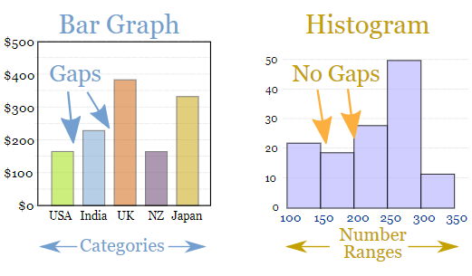
Histograms vs Bar Graphs
contd
https://www.mathsisfun.com/data/bar-graphs.html

Slide 54
Numeric and Categorical Structured Data Visualization- Part2 (multi-variate)

Slide 55
Stacked Bar Charts

Slide 56
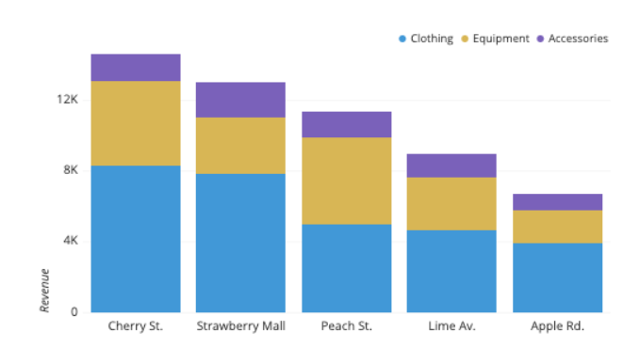
Stacked Bar Charts
Stacked Bar Graphs segment their bars. Stacked Bar Graphs are used to show how a larger category is divided into smaller categories and what the relationship of each part has on the total amount.
https://chartio.com/learn/charts/stacked-bar-chart-complete-guide/

Slide 57
Stacked Bar Charts
There are two types of Stacked Bar Graphs:
Simple Stacked Bar Graphs place each value for the segment after the previous one. The total value of the bar is all the segment values added together. Ideal for comparing the total amounts across each group/segmented bar.
100% Stack Bar Graphs show the percentage-of-the-whole of each group and are plotted by the percentage of each value to the total amount in each group. This makes it easier to see the relative differences between quantities in each group.

Slide 58
Stacked Bar Charts
Example
Books Read | Non-Fiction | Fiction
Jane | 5 | 12
Mike | 3 | 7
Jhon | 6 | 1
Siya | 7 | 2
Simple Stack Bar
100% Stacked Bar

Slide 59
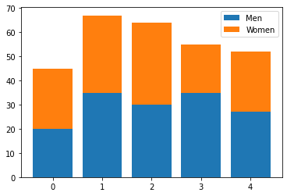
Stacked Bar Charts in Python
Type 1: Basic
The bottom parameter specified where to start instead of the default 0 value
import numpy as np
import matplotlib.pyplot as plt
menMeans = (20, 35, 30, 35, 27)
womenMeans = (25, 32, 34, 20, 25)
N = 5
ind = np.arange(N) # the x locations for the groups
p1 = plt.bar(ind, menMeans)
p2 = plt.bar(ind, womenMeans, bottom=menMeans)
plt.legend((p1[0], p2[0]), ('Men', 'Women'))
plt.show()

Slide 60
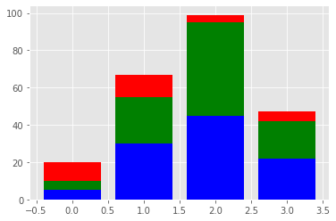
Stacked Bar Charts
Type 2: More than 2 categories
import numpy as np
import matplotlib.pyplot as plt
A = np.array([5., 30., 45., 22.])
B = np.array([5., 25., 50., 20.])
C = np.array([10., 12., 4., 5.])
X = np.arange(4)
plt.bar(X, A, color = 'b')
plt.bar(X, B, color = 'g', bottom = A)
plt.bar(X, C, color = 'r', bottom = A + B)
plt.show()

Slide 61
Disadvantages of Stacked Bar Charts
Disadvantages:
One major flaw of Stacked Bar Graphs is that they become harder to read the more segments each bar has.
Also comparing each segment to each other is difficult, as they're not aligned on a common baseline.

Slide 62
Grouped Bar Charts

Slide 63
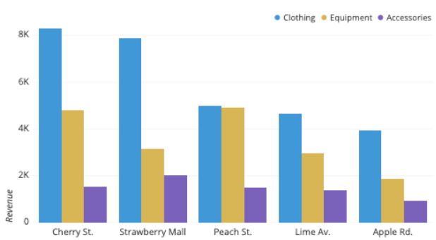
Grouped Bar Charts
If we unstack each of the primary bars and instead place the sub-bars in groups on the baseline, then we get a grouped bar chart, also known as a clustered bar chart.
With a grouped bar chart, we trade out our ability to observe the totals within each primary category level and gain a more precise understanding of how secondary categories rank within each primary category level.

Slide 64
Grouped Bar Charts
Example
Books Read | Non-Fiction | Fiction
Jane | 5 | 12
Mike | 3 | 7
Jhon | 6 | 1
Siya | 7 | 2

Slide 65
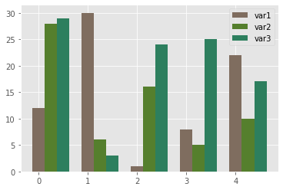
Grouped Bar Charts in Python
# libraries
import numpy as np
import matplotlib.pyplot as plt
# set width of bar
barWidth = 0.25
# set height of bar
bars1 = [12, 30, 1, 8, 22]
bars2 = [28, 6, 16, 5, 10]
bars3 = [29, 3, 24, 25, 17]
# Set position of bar on X axis
r1 = np.arange(len(bars1))
r2 = [x + barWidth for x in r1]
r3 = [x + barWidth for x in r2]
# Make the plot
plt.bar(r1, bars1, color='#7f6d5f', width=barWidth, label='var1')
plt.bar(r2, bars2, color='#557f2d', width=barWidth, label='var2')
plt.bar(r3, bars3, color='#2d7f5e', width=barWidth, label='var3')
plt.show()

Slide 66
Combination Line and Bar Charts

Slide 67
Combination Line and Bar Charts
Combination Line and Bar Charts
Sometimes we need to combine different types of charts together for better visualization

Slide 68
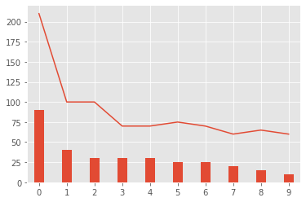
Combination Line and Bar Charts
import matplotlib.pyplot as plt
import numpy as np
import pandas as pd
width = .35 # width of a bar
m1_t = pd.DataFrame({
'abnormal' : [90,40,30,30,30,25,25,20,15,10],
'bad_rate' : [210,100,100,70,70,75,70,60,65,60]})
m1_t['abnormal'].plot(kind='bar', width = width)
m1_t['bad_rate'].plot()
plt.show()

Slide 69
Error Bar Charts

Slide 70
Error Bar Charts
Sometimes it is useful to show the amount of error that a bar can have
Error bars are useful to problem solvers because error bars show the confidence or precision in a set of measurements or calculated values.
Bar charts without error bars give the illusion that a measured or calculated value is known to high precision or high confidence.
https://problemsolvingwithpython.com/06-Plotting-with-Matplotlib/06.07-Error-Bars/

Slide 71
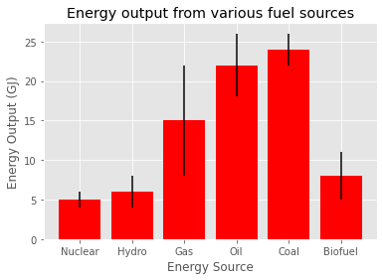
Error Bar Charts in Python
x = ['Nuclear', 'Hydro', 'Gas', 'Oil', 'Coal', 'Biofuel']
energy = [5, 6, 15, 22, 24, 8]
variance = [1, 2, 7, 4, 2, 3]
plt.bar(x, energy, color='red', yerr=variance)
plt.xlabel("Energy Source")
plt.ylabel("Energy Output (GJ)")
plt.title("Energy output from various fuel sources")
plt.show()
https://benalexkeen.com/bar-charts-in-matplotlib/

Slide 72
Simple graph in Excel

Slide 73
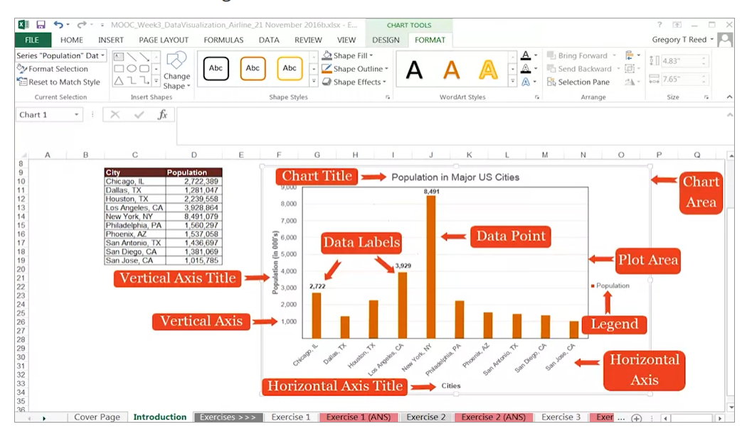
Simple Charts in Excel
excel has some really good and easy chart plotting features
Interested students are encouraged to look into it
(We are not covering this portion because our focus is on Python)

Slide 74
Summary
Numeric and Categorical Structured Data Visualization- Part1 (Univariate)
Pie Charts
Bar Charts
Line Charts
Histogram Charts
Stacked Bar Charts
Grouped Bar Charts
Combination Line and Bar Charts
Error Charts

Slide 75
References
Some portion of these slides re taken from the following places
Chapter 2 of book , A General Introduction to Data Analytics, by João Mendes Moreira, André C. P. L. F. de Carvalho
https://datavizcatalogue.com/methods/pie_chart.html
https://www.answerminer.com/blog/the-ultimate-guide-to-pie-chart-visualization
https://datavizproject.com/data-type/bar-chart/
https://www.mathsisfun.com/data/bar-graphs.html
https://datavizcatalogue.com/methods/line_graph.html
https://www.mathsisfun.com/data/histograms.html
https://chartio.com/learn/charts/stacked-bar-chart-complete-guide/

Slide 76
References
Pie chat in python: https://www.tutorialspoint.com/matplotlib/matplotlib_pie_chart.htm
Pie chart code: https://www.tutorialspoint.com/matplotlib/matplotlib_pie_chart.htm
Error bar charts
https://benalexkeen.com/bar-charts-in-matplotlib/

Slide 77
Gant Charts

Slide 78
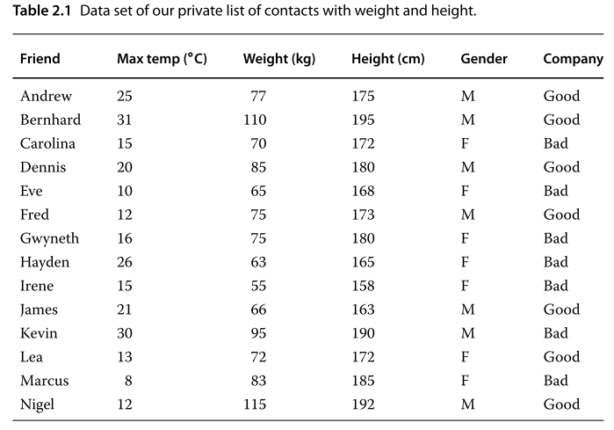
Data
Example

Slide 79
Conversion From one scale to another
Example 2.3 As an example, consider the attribute “weight” expressed in an absolute scale in kilograms. We can convert it to any other scale:
Add details here

Slide 80
Relative frwquency/ absolute frquncy ..
See some thing if needed

Slide 81
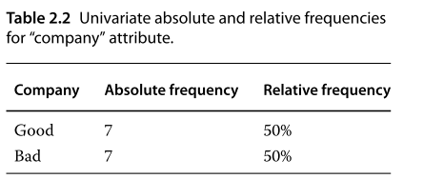

Slide 82
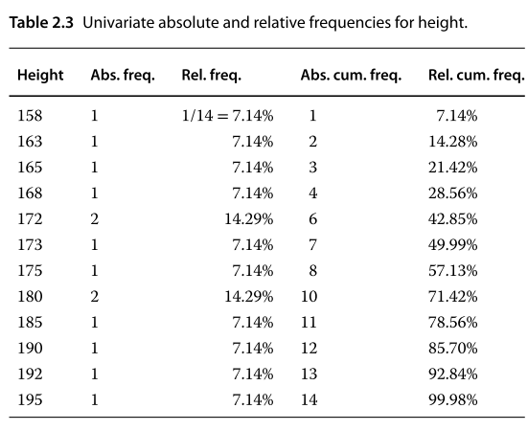

Slide 83
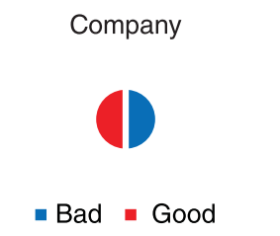
Pie Charts
contd
Our Example

Slide 84
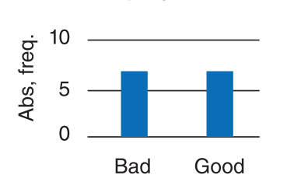
Bar charts
These are used typically for qualitative scales. When the notion of order exists, the classes should be displayed in the horizontal bar, typically in increasing order of magnitude.
Many authors argue that bar charts are better for comparing values between diﬀerent classes than pie charts because it is easier to see that one bar is bigger than another than to see that one pie slice is larger than another.

Slide 85
Bar charts
contd
In some situations bar charts are also used with quantitative scales, for example where the possible value of an attribute is limited in size.
For example, the result of counting the number of times each of the six faces of a die appears could be readily represented in a bar chart (integer numbers from 1 to 6).
Another example could be the number of students with a given mark on a 0–20 integer scale (integers from 0 to 20).

